Slide 1
Positional Number System
Decimal: Uses base 10
756 = 7x10² + 5x10¹ + 6x10⁰
Binary Number: Uses base 2
111 = 1x2² + 1x2¹ + 1x2⁰

Slide 2
Binary to Decimal
00002 = 0 | 10002 = 8
00012 = 1 | 10012 = 9
00102 = 2 | 10102 = 10
00112 = 3 | 10112 = 11
01002 = 4 | 11002 = 12
01012 = 5 | 11012 = 13
01102= 6 | 11102 = 14
01112 = 7 | 11112 = 15

Slide 3
Binary to Decimal
8 4 2 1
1 1 0 1
=
1x8 + 1x4 + 1x1 =
8 + 4 + 1 =13

Slide 4
Binary to Decimal
128 64 32 16 8 4 2 1
1 0 0 1 1 1 0 1
1x128 + 1x16 + 1x8 + 1x4 + 1x1 =
128 + 16 + 8 + 4 + 1 =
157
=

Slide 5
Definitions
A literal is a complemented or un-complemented Boolean variable.
Examples: a and ā are distinct literals. ā+cd is not
A product term is a single literal or a logical product (AND) of two or more literals.
a, ā, ac, ācd, aaāb are product terms
ā+cd is not a product term

Slide 6
A sum term is a single literal or a logical sum (OR) of two or more literals.
Examples: a, ā, a+c, ā+c+d are sum terms; ā+cd is not a sum term.
A sum of products (SOP) expressions is a set of product (AND) terms connected with logical sum (OR) operators.
Examples: a, ā, ab+c, āc+bde, a+b are SOP expressions.

Slide 7
A product of sum (POS) expressions is a set of sum (OR) terms connected with logical product (OR) operators.
Examples: a, ā, a+b+c, (ā+c)(b+d) are POS expressions.

Slide 8
The canonical sum of products (CSOP) form of an expression refers to rewriting the expression as a sum of minterms.
Examples for 3-variables:
ābc + abc is a CSOP expression;
āb + c is not.
The canonical product of sums (CPOS) form of an expression refers to rewriting the expression as a product of maxterms.
Examples for 3-variables:
(ā+b+c)(a+b+c) is a CPOS expression;
(ā+b)c is not.
There is a close correspondence between the truth table and minterms and maxterms.

Slide 9
Minterms
A minterm can be defined as a product term that is 1 in exactly one row of the truth table.
n variable minterms are often represented by n-bit binary integers.
How to associate minterms with integers?
State an ordering on the variables
Form a binary number
Set bit i of the binary number to 1 if the ith variable appears in the minterm in an uncomplemented form
Set bit i to 0 if the variable appears in the complemented form.

Slide 10
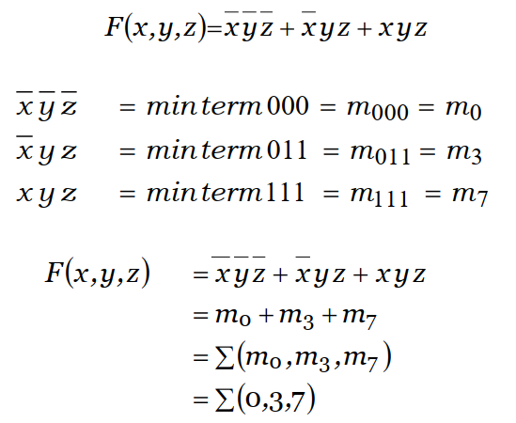
Minterm Examples
3-variable expression

Slide 11
Maxterms
A maxterm can be defined as a sum term that is 0 in exactly one row of the truth table.
n variable maxterms are also represented by n-bit binary integers.
How to associate maxterms with integers?
State an ordering on the variables
Form a binary number
Set bit i of the binary number to 0 if the ith variable appears in the maxterm in an uncomplemented form
Set bit i to 1 if the variable appears in the maxterm in the complemented form.

Slide 12
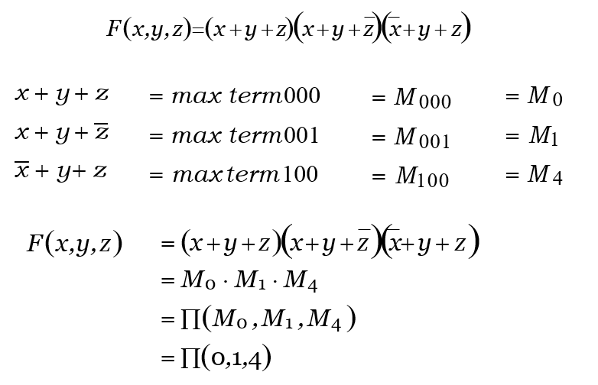
Maxterm Examples

Slide 13
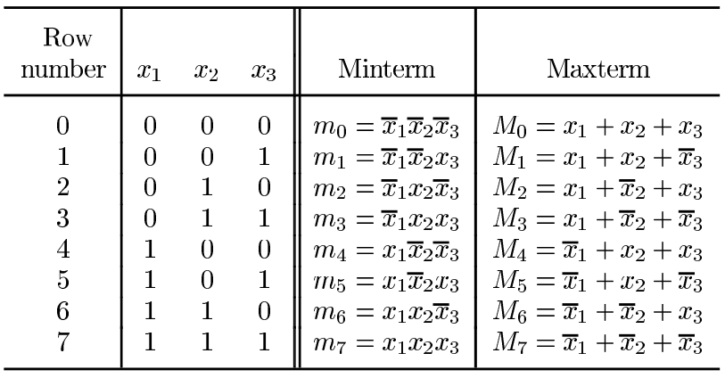
Minterms and Maxterms

Slide 14
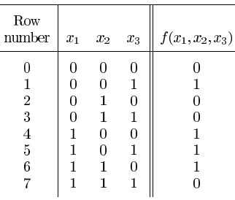
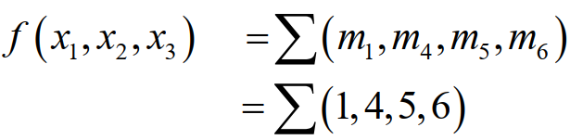
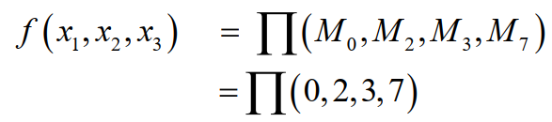

Slide 15
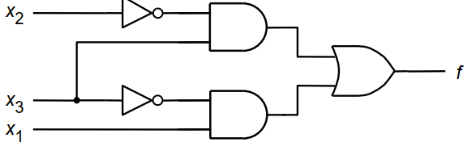
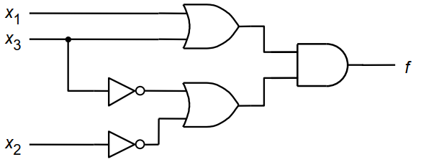
A minimal sum-of-products
A minimal product-of-sums

Slide 16















































Summary of Minterms and Maxterms

Slide 17
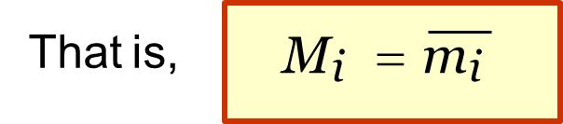
Conversion between SOP and POS
Conversion between ∑ and Π representations is easy.
Assume an n-variable function so the minterm and maxterm lists that represent the function are subsets of {0,1,……,2^{n} –1}.
It can be shown that the minterm indices and maxterm indices are complementary.
Example: Assume a 3 variable expression F(x,y,z).
∑(1,4,7) = ∏(0,2,3,5,6)
m₁ + m₄ + m₇ = M₀ ⋅ M₂ ⋅ M₃ ⋅ M₅ ⋅ M₆

Slide 18
Algebraic Simplification
To reduce circuit complexity and to maximize circuit performance, it is often necessary to write algebraic expressions in SOP or POS forms.
The rules discussed earlier are used to do the simplification.

Slide 19

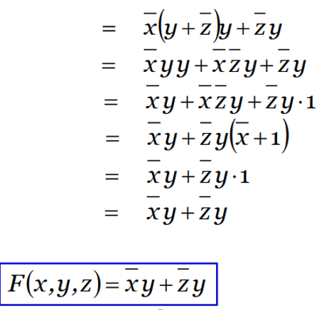
Example
Simplify to SOP form:

Slide 20

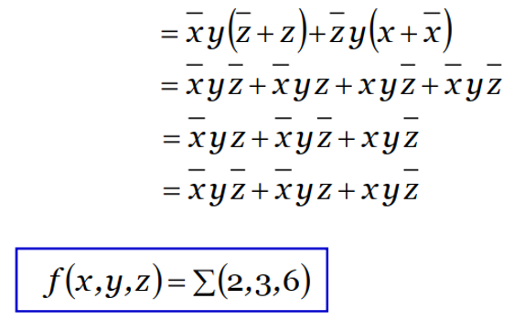
Example
Write the following to canonical SOP (sum of minterms) form.

Slide 21

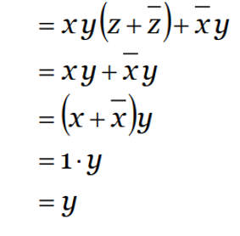
Example
Simplify to POS form

Slide 22

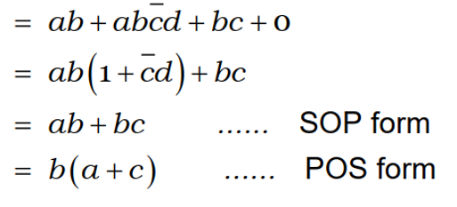
Example
Simplify to SOP and POS forms.

Slide 23

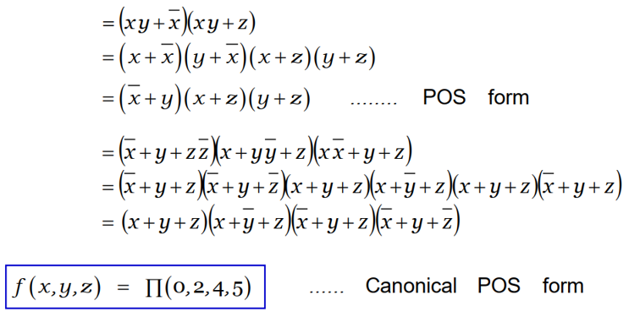
Example
Simplify to POS and expand to canonical POS (product of maxterms).

Slide 24

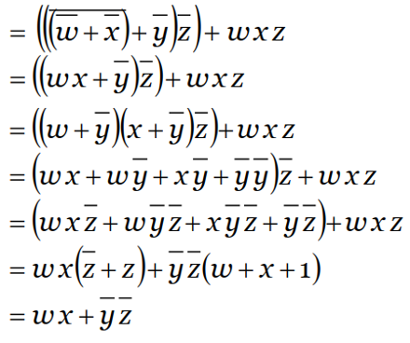
Example
Simplify to SOP form

Slide 25
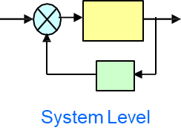
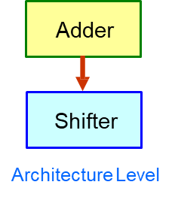

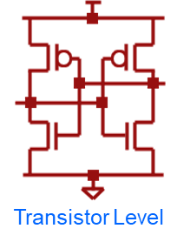
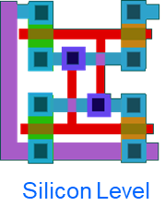
Abstraction Levels

Slide 26
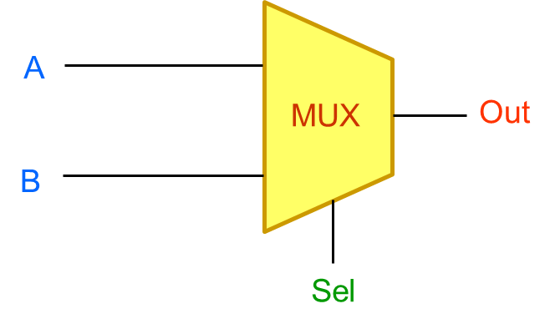
Design Representation (Example 1)
Multiplexer: Choose one of two inputs based on a control input
Sel: Select line and is a control input
A,B: Data Inputs
Out: Multiplexer Output

Slide 27
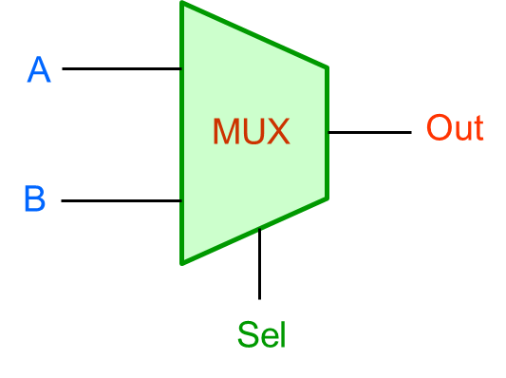

Textual Description
If Sel is `0’, choose A and pass it on to Out
If Sel is `1’, choose B and pass it on to Out
The value of A and B does not matter
Pass both 0’s and 1’s

Slide 28
Truth Table
Sel | A | B | Out
0 | 0 | 0 | 0
0 | 0 | 1 | 0
0 | 1 | 0 | 1
0 | 1 | 1 | 1
1 | 0 | 0 | 0
1 | 0 | 1 | 1
1 | 1 | 0 | 0
1 | 1 | 1 | 1
Boolean Equation
Out = Sel' . A + Sel . B

Slide 29
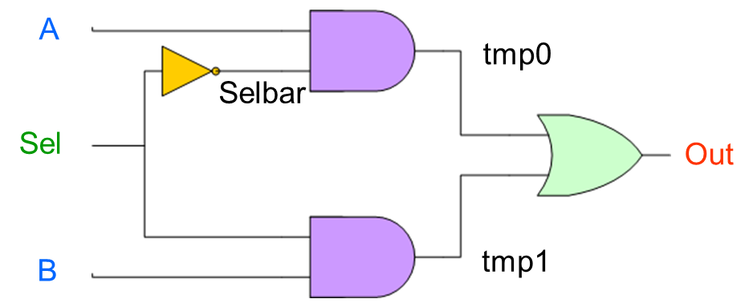
Gate Level Description

